Slide 1

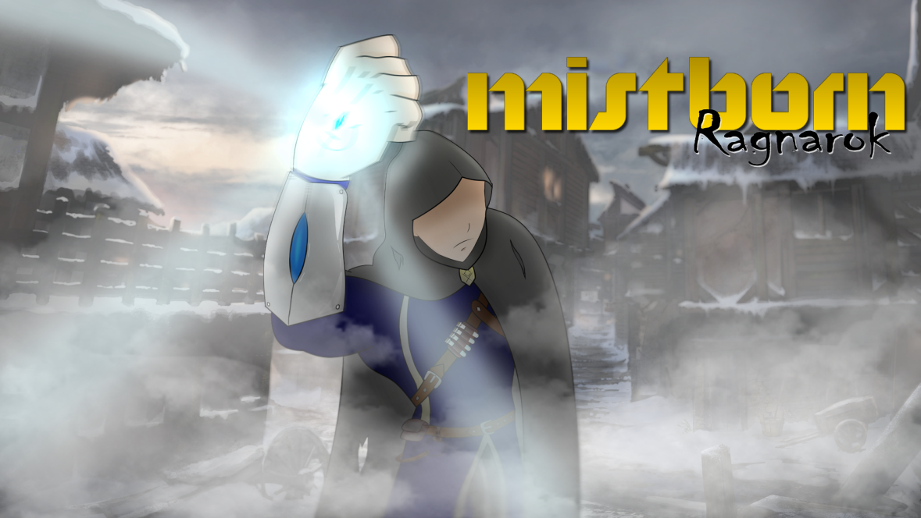
Mistborn – Ragnarok Aggressive Pigeon Game Studio COMP 376 FINAL PROJECT PRESENTATION
Christian Plourde – 26572499
Ayush Kharade - 40042388
Daniel Vellucci – 27416288
Samer Yazbeck – 40049573
Luciano Porchet - 40048537
“All Paths Lead To Ruin”

Slide 2
CHANGES
During the progress presentation we were unsure whether to keep Koloss in the game, mainly because such an enemy didn’t go well with the setting of our levels and also due to time constraint.
We dropped Koloss idea as an enemy.
Apart from that, we have implemented all other ideas that were proposed during the previous two presentations.

Slide 3
Game Structure
Level 1 → Introduce to Pull & Push powers. No major changes to this level.
Level 2 → Takes place right after level 1, introduces pewter. Player also has to use their previously acquired abilities and platforming in order to beat this level.
Level 3 → Boss Fight

Slide 4
New features added (Major features)
Pewter Functionality → Allows players to be strong and agile, allows them to punch enemies. This gives the players a reliable way to fight enemies
Second level → happens right after the first level, has two major puzzles and also platforming sections.
Level also has a dark, unsettling feel to it as part of the level design to make players feel uneasy while going through it.
Coinshot enemy → Ranged enemy added to the game
Implemented boss level and boss fight.
Added Lore notes in levels that help explain the story.
Notes also have instructions on how to use newly acquired powers.
Cutscenes added to boss level to explain story and also the aftermath conclusion of the game.

Slide 5
New features added (Other features)
Added a Pause Menu, as it was suggested during the progress presentation.
Added a main menu.
Added sounds for ambience and most player actions.
On screen prompts when near an interactable objects.
Shader highlighting objects that can be pulled or pushed when powers are active.

Slide 6
Thank YOU We will now present our game!

